Slide 1
10.009 Digital World
Week 1
Man, Geok See

Slide 2
Schedule
Week 1 to 6: Basic Python programming, numerical programming (procedural programming), problem solving framework
  Weekly quizzes
    Concept quiz: beginning of 1st class
    Programming quiz: beginning of 3rd class
  Weekly homework (usually due on end of Monday the following week)
  Mini-project
Week 7: Spring break!! ☺
Week 8 to 14: Object-oriented programming, state machines, robot control, 2D project (Week-11)

Slide 3
Topics
Writing program for mathematical formula (i.e., use the computer as calculator)
  Introduction to Canopy / IDLE
  Variable and assignment
  Numeric data type
  Arithmetic operations
  String data type
  Flowcharts

Slide 4
Install Python
Download Python 2.7.x from Enthought Canopy Express: https://store.enthought.com/downloads/
We use Python 2.7
After installation, try ‘Canopy’

Slide 5
Introduction to Canopy
Python Shell (Python Pane): Interactive environment for you to enter Python computer instructions (statements)
Python Editor (Code Editor): Write a Python program (script)
  Program: A set of instructions to the computer that specifies some computation
  Steps:
    File -> New -> Python File
    Enter your program
    Save your program (xxx.py) [Ctrl-S]
    Run (from the editor window) [Ctrl-R]
    See your results in Python Shell

Slide 6
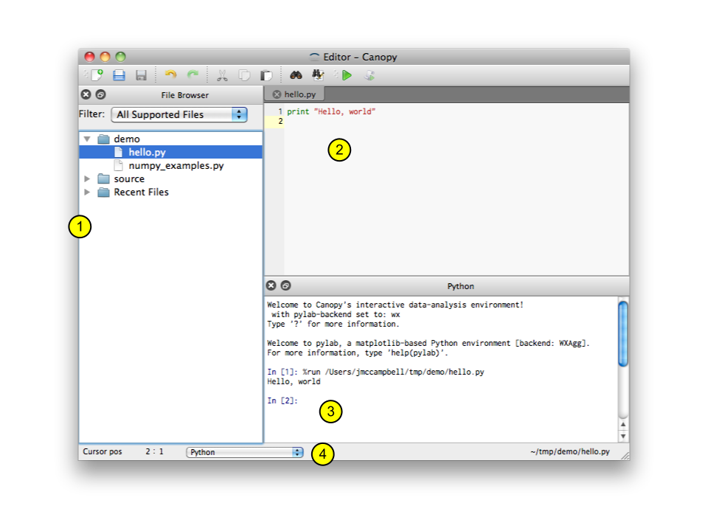
Introduction to Canopy
File browser pane
Code editor
Python pane
Editor status bar

Slide 7
Introduction to IDLE
Python Shell: Interactive environment for you to enter Python computer instructions (statements)
Python Editor: Write a Python program (script)
  Program: A set of instructions to the computer that specifies some computation
  Steps:
    File -> New Window (new editor window)
    Enter your program
    Save your program (xxx.py) [Ctrl-s]
    Run (from the editor window) [F5]
    See your results in Python Shell

Slide 8
First Python Program
Position of a ball in vertical motion: y = u*t – 1/2 * g * t²
u=5, g=9.81, t=0.6
Enter this in the interactive shell / editor window and run it:
print: output the results to standard output
How about to calculate y at another t?
print 5 * 0.6 – 0.5 * 9.81 * 0.6**2
Notes:
Print statement
print evaluates each expression in turn and writes the resulting object to standard output (see below). If an object is not a string, it is first converted to a string using the rules for string conversions. The (resulting or original) string is then written. A space is written before each object is (converted and) written

Slide 9
Variable and Assignment
Express the formula (program) in terms of variables (symbols)
  Variable is a name that refers to a value (an object, in general)
  Assignment: assign a value to a variable (assign an object, in general)
Other assignments:
u = 5 # this instruction is an assignment, and I am a comment
g = 9.81
t = 0.6
y = u * t - 0.5 * g * t**2
print y
u = 5
u = u + 1 # note that this is ok. This is an assignment, not equality
Notes:
Variable: name of an object

Slide 10
Numeric data (object) type, Arithmetic Operators
int
  Integer, i.e., whole number (int)
float
  Real number / decimal number (float)
  float is just an approximate representation for real numbers (due to finite precision in computer)
complex
a = 2.5 + 3j
b = complex(6, 3.1)
How to compute: j²
Notes:
>>> type(32)
<type 'int'>
>>> type(32.1)
<type 'float'>
>>> type(32l)
<type 'long'>
>>> type(32L)
<type 'long'>
>>> type(3+4j)
<type 'complex'>
What is type?
print type.__doc__

Slide 11
Data type: String
Piece of text / Sequence of characters (str) / String of letters
Within single quotation (‘) or double quotation (“) marks
Some operators on string
len(a): length of the string in characters
a = ‘hello’
b = ‘1.2’
c = ‘b’
>>> a='hello'
>>> b='class'
>>> print a + b
helloclass
>>>

Slide 12
Some built-in functions
Function: take an input, perform computation, produce the output.
Built-in function: already available provided in the Python package.
int(x): return an integer from a number or string; If x is floating point, the conversion truncates towards zero.
How about float(x), str(x)?
type(x): return the type of a variable (an object)

Slide 13

Numeric data (object) type, Arithmetic Operators
Arithmetic operators: +, -, *, /, **, % (modulo), // (floor_division)
Be careful with integer division!!!!
  In a/b, when both a and b are integers, the result is truncated (rounded down)
To use float division, enforce one of the operands to be a float
print 1/2
print 1.0/2
print 1/2.0
print float(1)/2

Slide 14
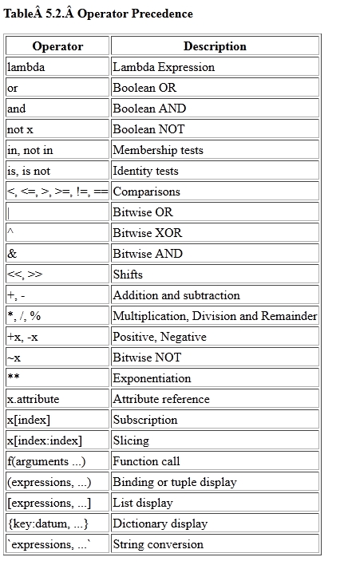
Arithmetic operator precedence
Same as Math
Use parentheses if you are not sure!!
Associativity: order in which an expression is evaluated that has operators of the same precedence
  Left-to-right for almost all operator
  Right-to-left for exponent
Compute first
Notes:
>>> 3+ 5 % 2.2
3.6

Slide 15
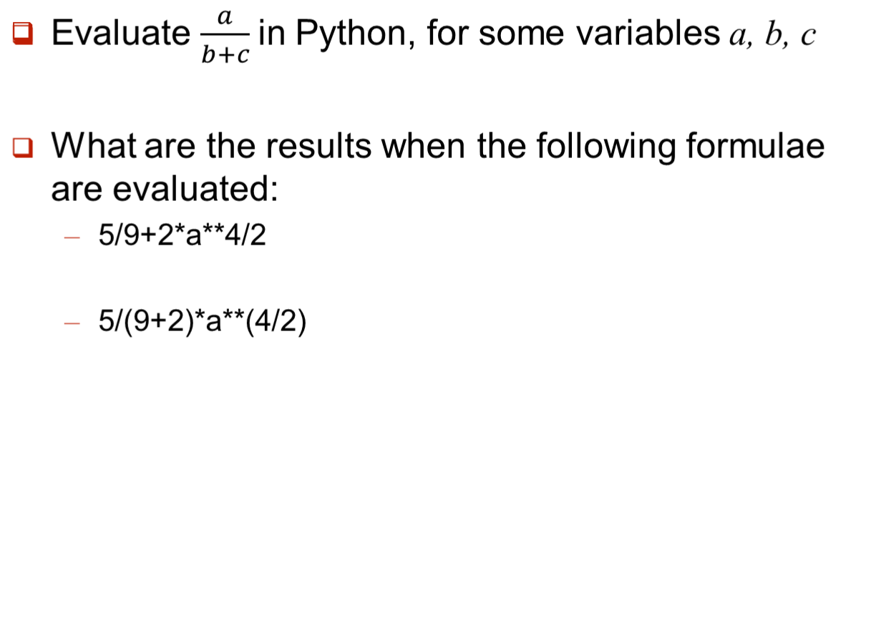
Numeric data (object) type, Arithmetic Operators

Slide 16
Flowchart
Diagrams that illustrate the sequence of operations to be performed to obtain the solution
For analysis, design and document of a computer program
Our focus: allow you to analyze the problem and design the solution, before jumping to programming

Slide 17
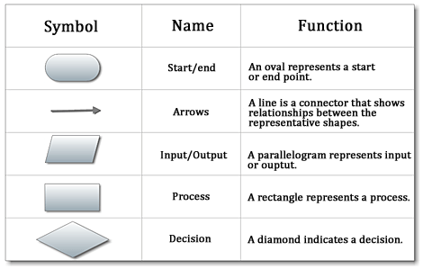
Flowchart

Slide 18
Flowchart
Example 1: The program takes input of two numbers, computes the sum, displays the sum.

Slide 19
Flowchart
Example 1: The program takes input of two numbers, computes the sum, displays the sum.
start
Sequential
input num1, num2
sum=num1+num2
print sum
end

Slide 20
Flowchart
Example 2: The program takes input of a person’s age, display ‘happy’ if age is less than 25, ‘sad’ otherwise.

Slide 21
Flowchart
Example 2: The program takes input of a person’s age, display ‘happy’ if age is less than 25, ‘sad’ otherwise.
start
Conditional
input age
age < 25 ?
yes
no
print ‘happy’
print ‘sad’
end

Slide 22
Flowchart
Example 3: The program takes input of a number and displays it. Do this for 20 numbers.

Slide 23
Flowchart
Example 3: The program takes input of a number and displays it. Do this for 20 numbers.
start
Iterative
count=0
yes
input number
print number
no
count=count+1
count < 20 ?
end

Slide 24
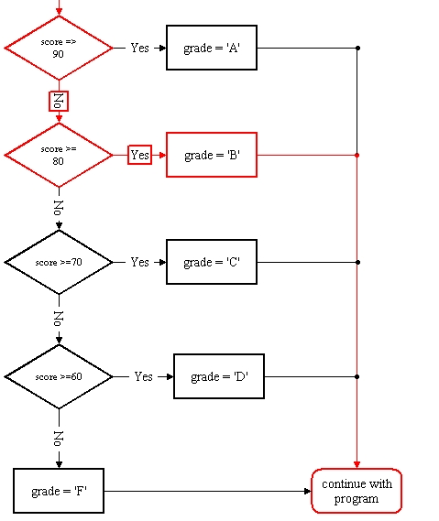
Flowchart: Partial answer to 9.c

Slide 25
Pseudo code
Informal high-level description of the computation
Example: The program takes input of two numbers, computes the sum, displays the sum.
input n1
input n2
s = n1 + n2
print s

Slide 26
Pseudo code
Example: The program takes input of a person’s age, display ‘happy’ if age is less than 25, ‘sad’ otherwise.
input age
if age less than 25
display ‘happy’
else
display ‘sad’

Slide 27
Pseudo code
Example 3: The program takes input of a number and displays it. Do this for 20 numbers.
Repeat this 20 times:
input a number
display the number

